Slide 1


Slide 2


Slide 3


Slide 4
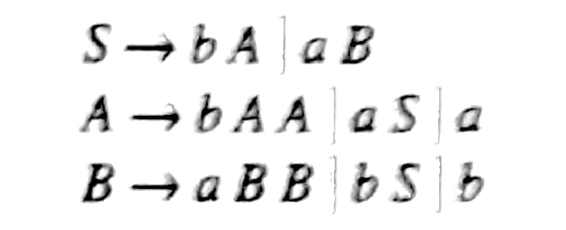
Convert the following CFG to CNF
For converting given grammar to CNF, first eliminate empty and unit productions from the grammar. Then convert the new grammar to CNF.

Slide 5
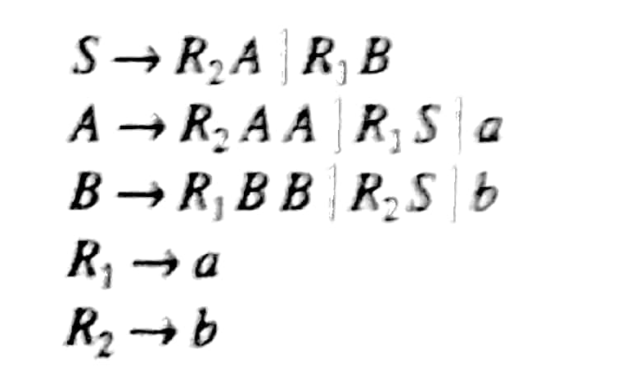
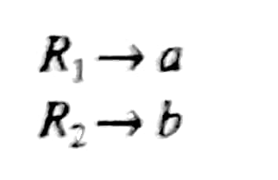
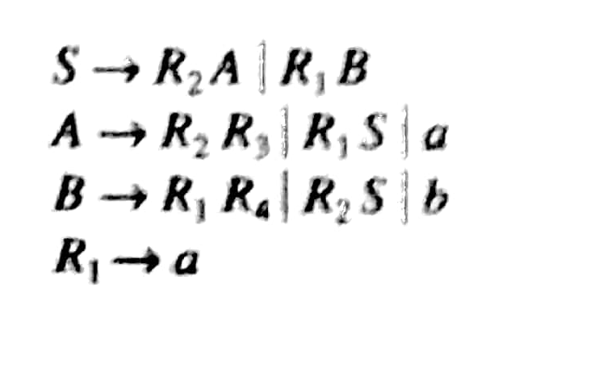
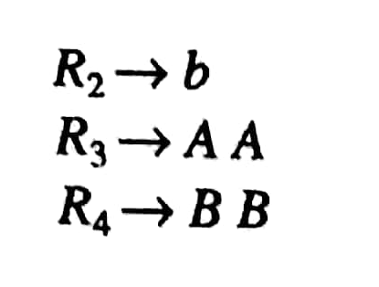
Convert the following CFG to CNF
Add two productions:
Add two productions
R3 -> AA
R4 -> BB

Slide 6
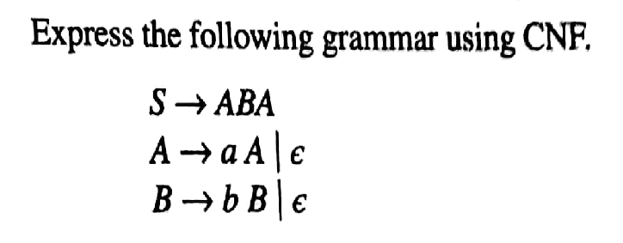
CNF

Slide 7
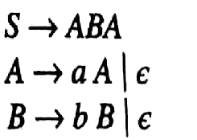


CNF

Slide 8

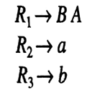
CNF

Slide 9
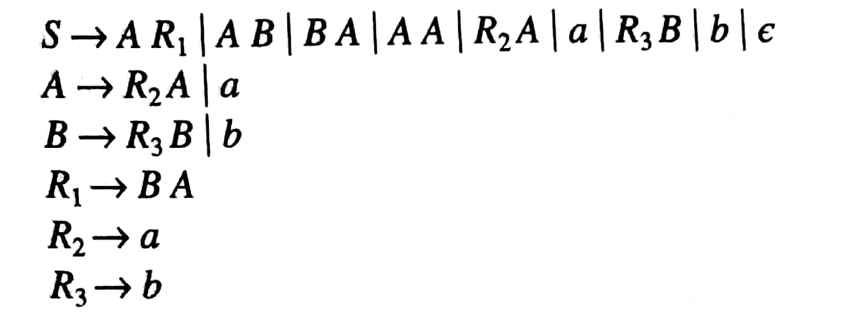
CNF
Note: We have added S -> ε to grammar in CNF form because the language L(G) generates ε string.

